Slide 1
Transnet – Agbiz Grain Engagement

Slide 2
Transnet Overview
Transnet as an integrated Logistics company operates freight rail networks, pipeline networks, Ports and Port Terminals and Manufacturing.
Revenue of R72.9 billion
Operating Expenses of R40.4 billion
EBITDA of R32,5 billion with a margin of 44.6%
Net Profit after tax and interest of R4.9 billion
Capital Investment in 2017/18 of R21.8 billion with investment over past 6 years of R165.6 b
2.9% of personnel costs involved in training with the focus on Artisans, Engineers and Engineering Technicians
B-BBEE spend of R25.8 billion or 86.9% of measured procurement spend
Rail Volumes:
  General Freight 90.8 million tons (3.2% increase)
  Coal Export 77.0 million tons (13.1% increase)
  Iron Ore 58.5 million tons (7.7% increase)
  Total Rail 226.3 million tons (7.6% increase)
  Containers through ports 4.664 million TEU (3.6% increase)

Slide 3
The Transnet of Tomorrow
Transnet 4.0

Slide 4
Transnet of tomorrow – Where are we heading?

Slide 5
Transnet of Tomorrow – 8 Ways digitalization is changing our business

Slide 6
Transnet of tomorrow – Optimising the value chain

Slide 7
Transnet of tomorrow – Where to next?

Slide 8
Transnet of tomorrow – Business Growth – Key trends affecting logistics

Slide 9
Transnet of tomorrow – Growth, collaboration and diversification

Slide 10
Transnet of tomorrow – Customers at the core of our business

Slide 11
Transnet of tomorrow – Customers at the core of our business

Slide 12
The Transnet of Tomorrow - summary

Slide 13
The Private Sector Participation Model

Slide 14
PSP defined
In the broadest, and simplest, sense, PSP simply means involving the private sector in functions or activities previously carried out by the public sector i.e. the State or State Agencies/Institutions/Authorities/Entities
Spectrum of PSP options
Service contracts
management contracts
Public-Private partnership
Outsourcing
Divestiture & sale
Special Purpose Vehicle (SPV)
Concession
Strategic Equity Partnership (SEP)
BOT/BOOT/
FBOT
Joint Venture (JV)
Privatisation
PPP’s are but one form of PSP

Slide 15
Benefits of leveraging the private sector
  Fiscal relief;
  Provision of investment capital;
  Introduction of new technologies – such as Skiptainers and Bi-modal systems;
  Improvements in quality of service;
  Increased innovation;
  Improved customer choice;
  New investment to meet growing demand;
  Broaden the freight rail industry cluster;
  Increase specialisation in the rail freight sector;
  Improve industry competiveness, profitability and attractiveness;

Slide 16
TFR criteria and conditions for PSP/PPP
Criteria
Strategic fit
Supporting growth portfolios i.e. Intermodal, Coal, Magnetite, etc.
Supporting national imperative, i.e. road to rail projects
Value for Money
Balancing of Risk
Conditions
Customer / Industry willingness to contract long term
Contractual guarantees should overlap asset repayment guarantees
Customer / Industry invests in loading / off loading facilities
Schedules aligned to strategy of scheduled, predictable and reliable railways
Value for money proposition for both parties
Balancing of risks in terms of market risks, capacity guarantees, volume guarantees, etc.
TFR’s capacity guarantees can be provided
Supporting BEE initiatives – coal and manganese examples

Slide 17
PSP Opportunities being explored and being implemented
Ownership of wagons
Long term lease of wagons
BOT of new freight terminals
Existing Terminals
Tramming activities
Branch Line Concessions
Potential Key network concessions

Slide 18
The Branch Line Strategy
As approved by the Board of Directors and the Minister of Public Enterprises

Slide 19
What happened since the last presentations?
RFP Competitive Process
  Decision was taken to only start with the Belmond Douglas railway concession
  5 parties purchased the tender documents by the end of the deadline to participate
  2 additional parties requested permission to participate but was denied due to the rules of the RFP as published
  Only 1 of the parties submitted a formal response to the RFP
  After due-diligence Transnet disqualified the bid as the minimum requirements as per the RFP process was not submitted by the respondent
  The bidder was informed that the bid was not successful
Unsolicited Concessions
  3 requests were received in terms of the Transnet PSP policy provisions
  All 3 requests were approved by the Board of Directors after a full due-diligence
  The Minister of Public Enterprises after consultation with National Treasury approved the 3 concessions in terms of the Public Finance Management Act.

Slide 20
Approved Concessions
3 Concession opportunities fully approved by the Board of Directors and the Minister in terms of the PFMA
All Concession Agreements have been signed
Award letters with the signed Concession Agreements were forwarded to the Concession companies in June 2018
Process to conclude all anciliary agreements and schedules have now commenced:
  Commercial Agreement
  Operations and Management Agreements
  Access Agreement
  Safety Interface Agreement
  Land lease agreements
  Property identification and schedule
  Condition of railway line and assets – schedule
  Rolling stock lists – locomotives, wagons and coaches included in the Concession
Expected time to conclude – 6 months to 12 months

Slide 21
Wolseley Prince Alfred Hamlet (Ceres Concession)
Will be first concession to reach closing
Will add traffic to the Cape Town main line
  Fruit to the Port of Cape Town
  Fruit and Juice to Johannesburg
  Coal from Johannesburg to Ceres
  Potatoes and Onions to Johannesburg
  Packing material from Worcester to Ceres
Tourism development will add tourism trains on the network
Concessionaire will receive as part of the concession:
  4 diesel locomotives
  4 class 38 locomotives
  160 SMLJ wagons
  Heritage assets – Red Devil

Slide 22
Amabele – Umtata Concession
Conclusion of Commercial agreements with rates will be biggest challenge
Will add traffic on the East London main line
  Increase from current 30 loaded wagons between Queenstown and East London per week to more than 150 loaded wagons per week – significant densification that will assist in reducing cost.
  Traffic will flow to and from Gauteng and to and from Cape Town
  Possibility for traffic to and from Port Elizabeth
Property identification with issues with old TBVC states being addressed between TFR and TP
Concession will receive following assets:
  4 diesel locomotives
  160 SMLJ wagons

Slide 23
Alicedale – Port Alfred (Grahamstown Concession)
Focus initially not on freight but on:
  Property development
  Optic Fibre
  Tourism potential with cycle routes
  Municipal waste treatment plant
Later focus on freight:
  Municipal waste to Alicedale from Grahamstown but also bigger Eastern Cape (Port Elizabeth, East London etc.)

Slide 24
New Unsolicited Approaches
TFR received proposals and this will be put forward for approval as unsolicited approaches
  George Knysna Railway Line
  Cookhouse Blaney Railway Line
  Xanadu Station to Nefdt Station (Jasmyn to Peaconwood on Hercules Magalies Railway Line)
Approval process:
  Transnet Freight Rail EXCO to support and recommend
  Group Leadership to support and recommend
  Board of Directors to approve subject to Ministerial approval in terms of the PFMA
  Minister of Public Enterprises approve in terms of the PFMA after consultation with Treasury

Slide 25
New RFP process for concessions
Intend to launch a RFP process in September 2018
Public process
Competitive bid
Agreement with DPE that lines will be put forward in a RFP process
  Pienaarsrivier to Marble Hall
  Belmond to Douglas
  Addo to Kirkwood
  Port Elizabeth to Avontuur Narrow Gauge Line
Sterkstroom to Maclear Railway Line

Slide 26

Draft Branchline Strategy Presentation
Steering Committee Session
22 September 2016
Inter-ministerial Committee on a new Branch Line Strategy
Waiting since October 2016 for a time to present to Cabinet to ensure acceptance of the Branch Line Strategy

Slide 27
Road to Rail strategy and collaboration

Slide 28
Road to Rail – What must be done to support the Grain Industry?
Re-establish shorter routes through Balfour and Wolwehoek for Eastern Free State Branch Line
Use the Orkney Vierfontein Link to shorten distance from Klerksdorp to Durban and East London as well as from Kroonstad Cluster to Randfontein
Prioritise high capacity lines
Prioritise high output silos
24/7 working in accordance to a service design
Load train when arrive on time appointments – trucks to wait
Collaborate to reduce cost – design towards lowest costs
Define short term interventions
Explore Wagon PSP opportunities

Slide 29
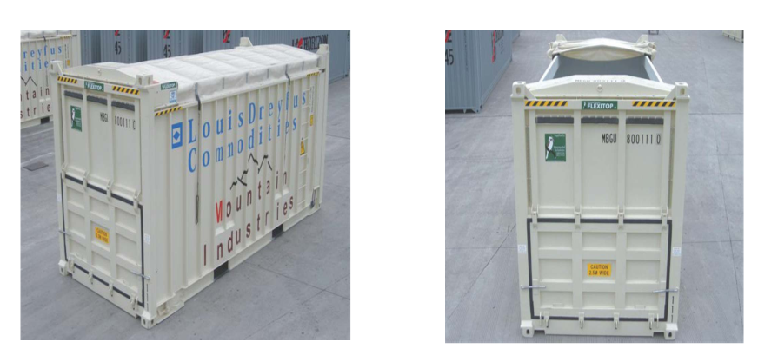
Road to Rail – Intermodalism potential for Grain

Slide 30
Road to Rail – Intermodalism potential for Grain

